Slide 1
Revenge Of The Shade
Aorion.A
Nigel.Lim
Rong Sheng
Edward Seah

Slide 2
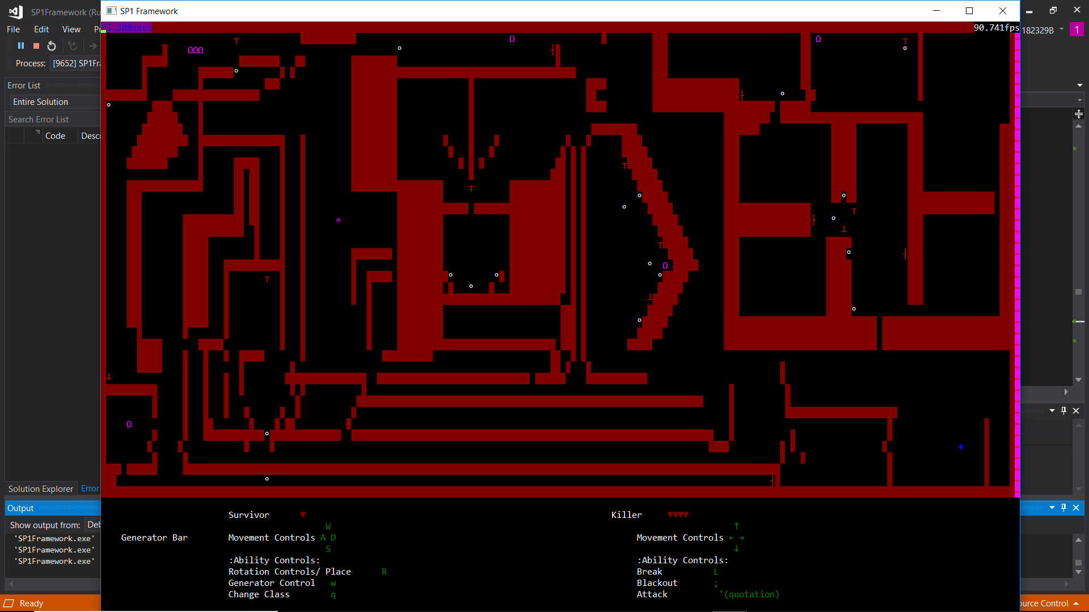
Notes:
-2 D Top Down PvPActivate the Shrines, choose your hero , fight your opponent
Maze Game

Slide 3
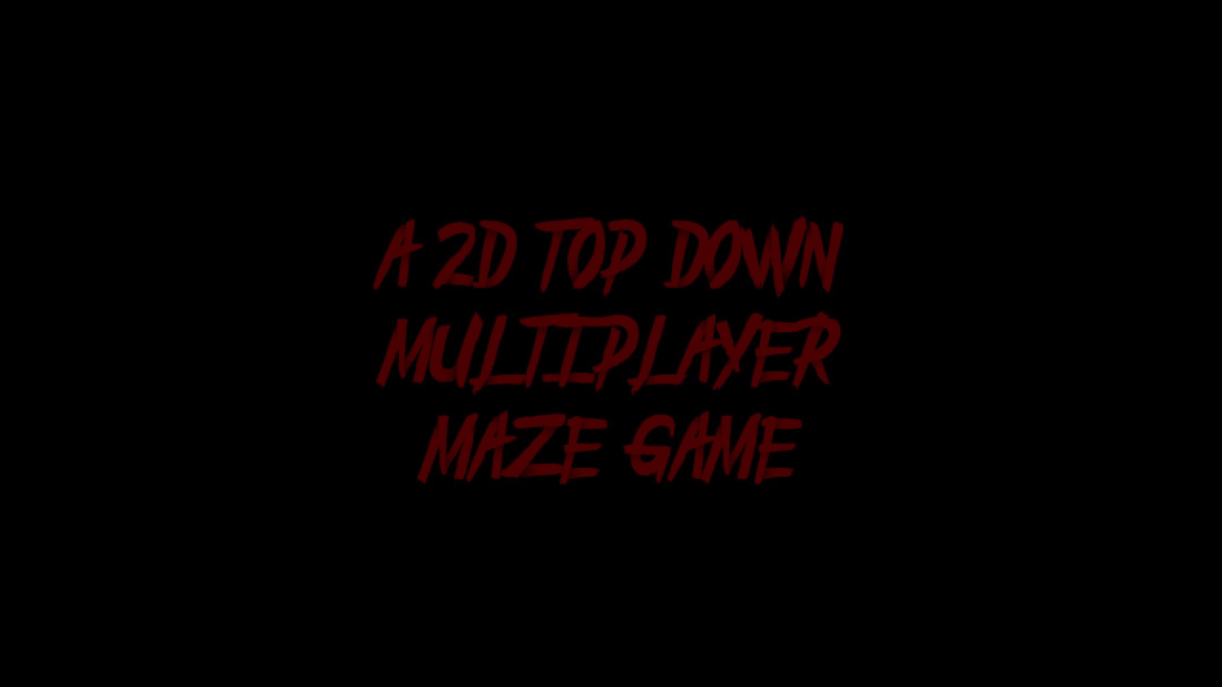
Trailer
Notes:
https://drive.google.com/open?id=10RxUEovpNUomoRwL7XaWL7FPtGFW5D7i

Slide 4
Inspired by :
Dead By Daylight

Slide 5
What’s Unique?
-Manipulation of Environment
-Player vs Player aspect

Slide 6
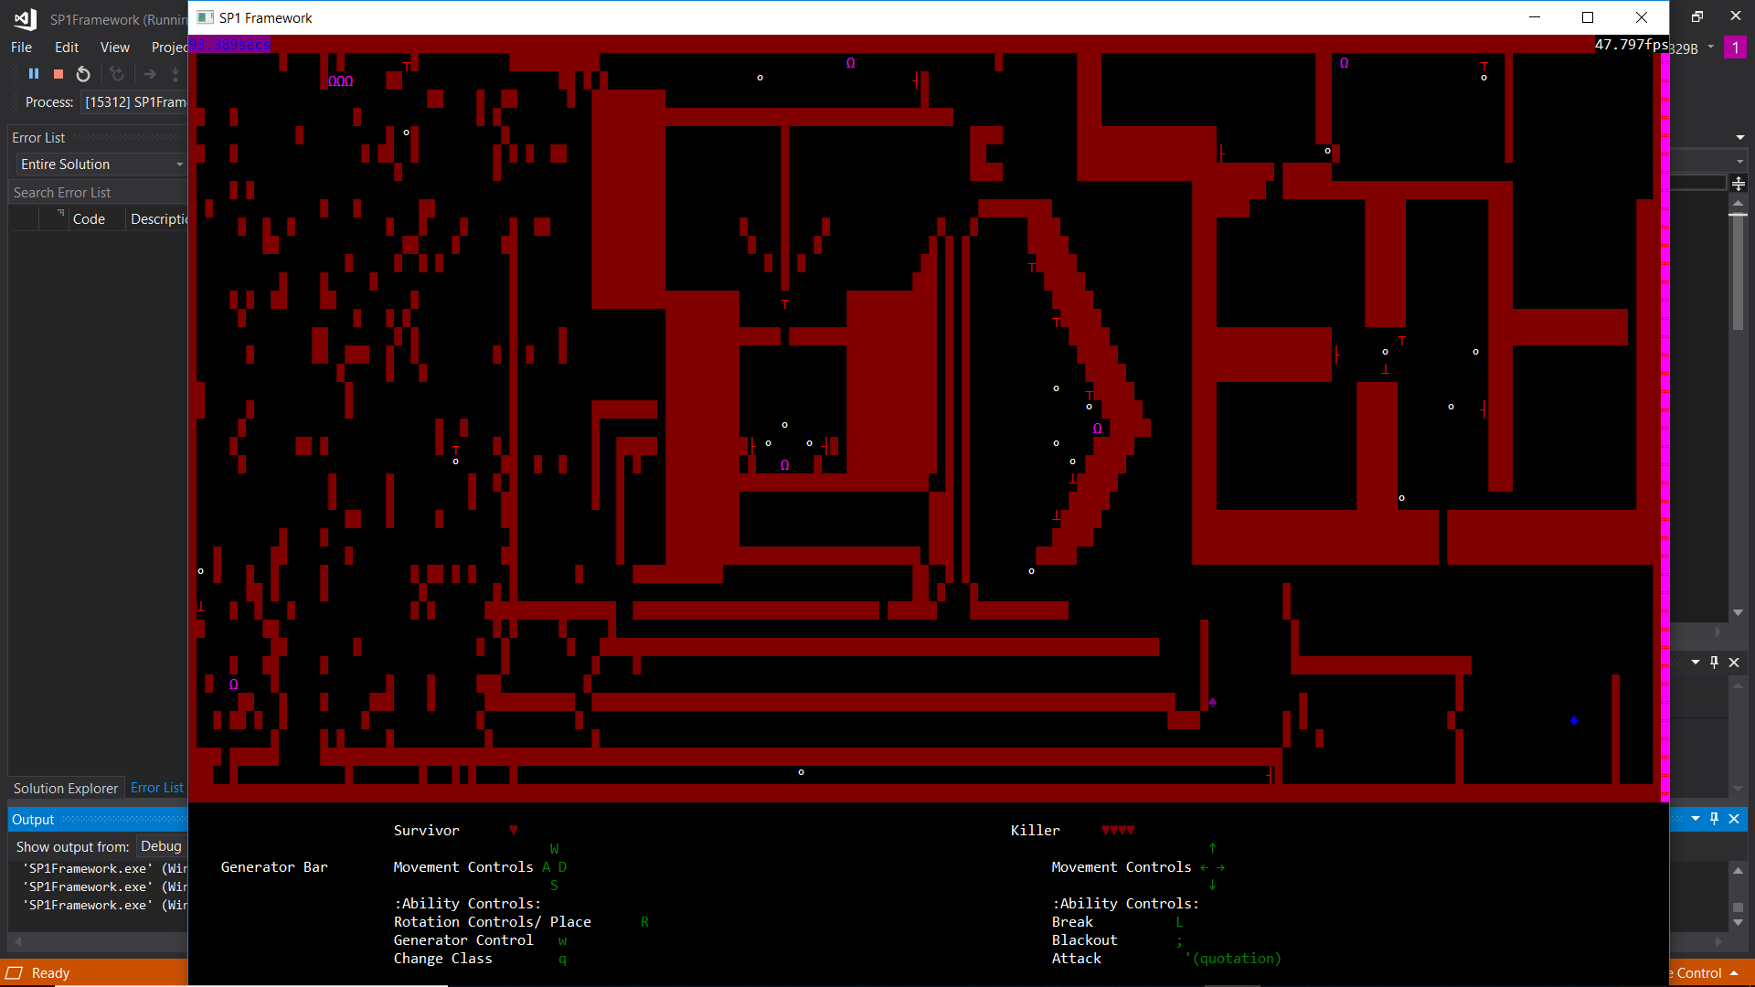

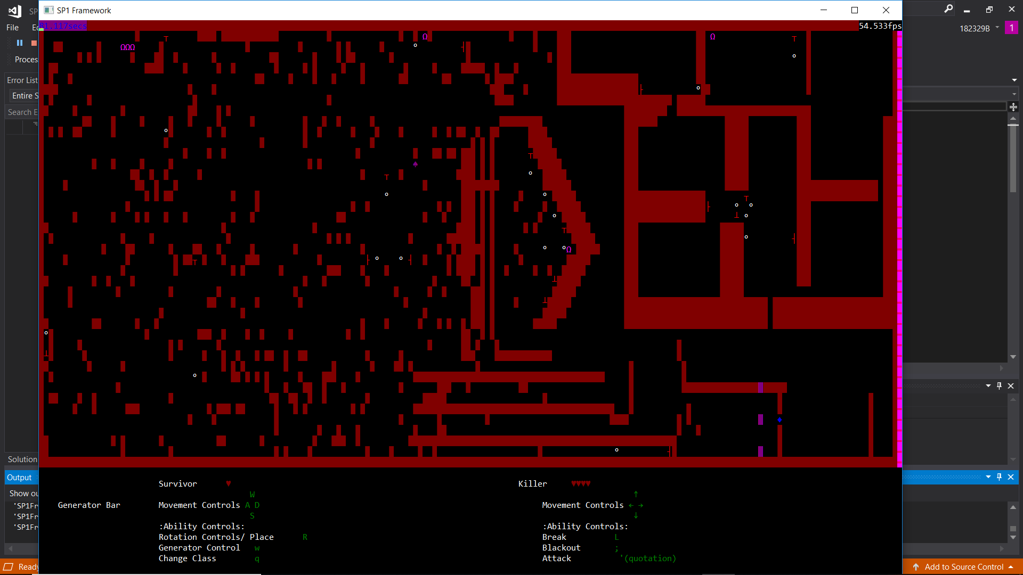
Game Mechanics
Rotated
-Rotation of walls
-Ability to Destroy Walls
Destroyed
Notes:
Rotation of walls- say its survivor ability talk about potential of outplay when the killer is chasing or smt
Breaking of walls- say its killer ability talk about the counterplay it provides but the kill must be careful when using cause of the cooldown so cannot anyhow use

Slide 7

Survivor’s Rotation

Slide 8
Killers can break wall

Slide 9
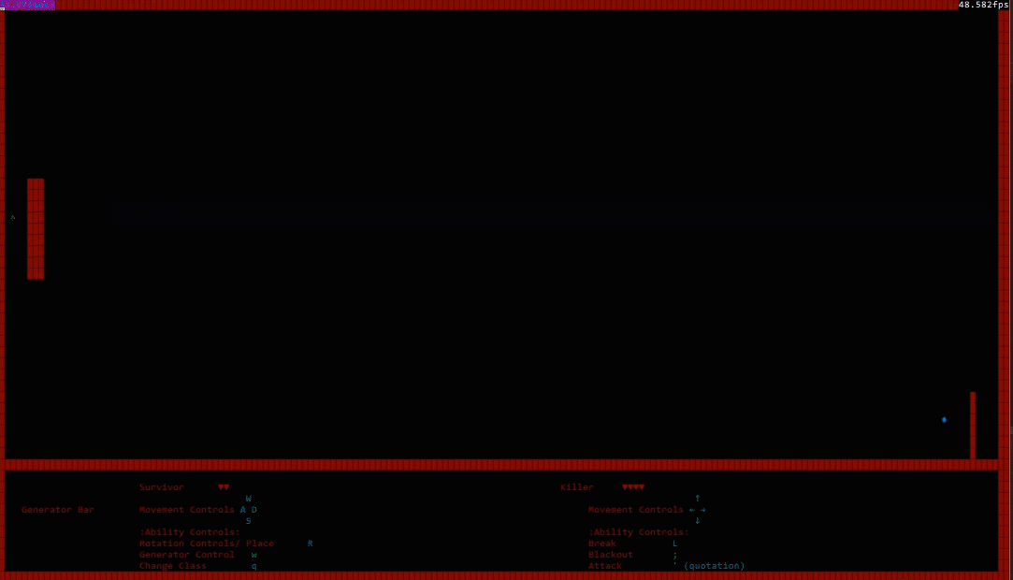
DESTRUCTION !
Notes:
Say this another one of the desttructive abilities called meteor strike or comet either.(long cooldown can kill self)

Slide 10
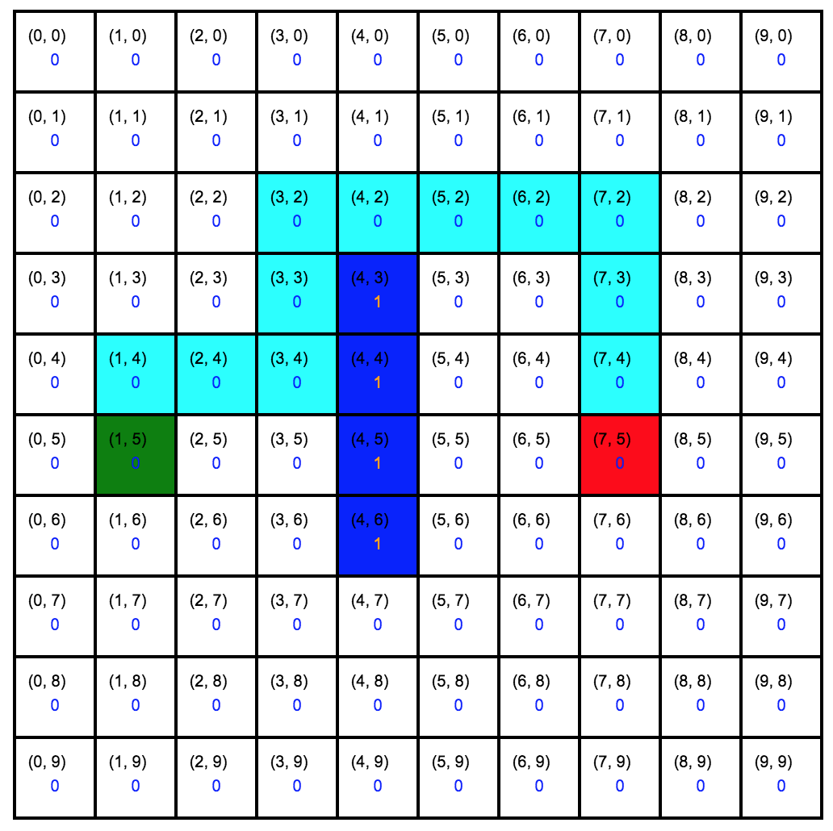
Artificial Intelligence
-A.I

Slide 11
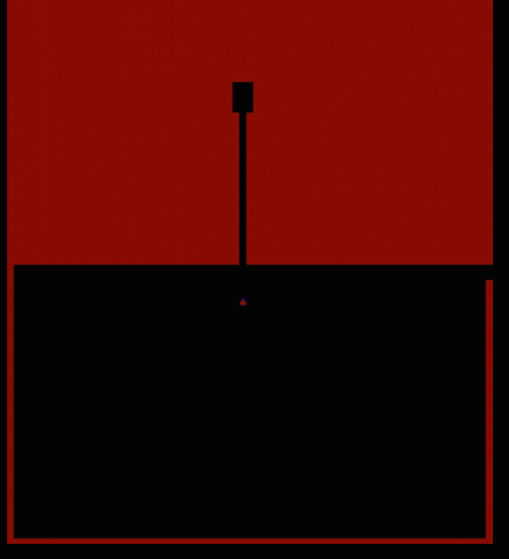
Characters we have
Knight
Commet
Swordsman
Samurai
Notes:
Talk bout what they music is suppose to be or make the person feel
Talk bout what the particle makes you feel when u see it (example when the wall destroyed got sound and particle) (can say player will be more inclined to play more cause its fun)
The sound and music of the game is supposed to make you feel uneasy, for example the menu music is mysterious, which will draw the player in more. The music for the actual game is eerie, making the atmosphere of the game much creepier. The sound effects is loud and obvious, to let the other player constantly know what their opponent is doing even if they’re not paying attention. For example, the killer has the ability to break walls, where it produces a loud noise. This will hopefully instill some fear into the survivor, since it means that the killer is one step closer to them.
When you break or destroy parts of the map as seen earlier, you can see that the effects are very flashy. This is to let the player feel more involved in the game, since the change in the map is significantly more obvious to them. They are our main mechanic of the game, where we want the map to be altered and changed to make every playthrough different. This will give our game more replay value and will leave a lasting impression on our players.
For the color scheme of the game, we all decided to go with red and black, since both of the colors look creepy, and since that’s what we were going for, we went with them. The player characters have different colors as we want them to stand out so that out players will know where they are at all times, since sometimes things may get a bit hectic. The spotlight also serves the same function, where it makes the game more creepier and drags out the game, where the killer can’t just make a beeline for the survivor, and must also traverse the maze to find the survivor.

Slide 12
Aorion
-MainMenu
-UI
-RenderMaps
-Tutorial
-Start screen & Win Screen

Slide 13
Problems Faced By Aorion
-UI was unclear
-How to play instructions were unclear

Slide 14
Task Completed By Nigel
Single Player A.I
Particle System
A* Pathfinding
Optimise Code
Classes’ Abilities

Slide 15
Problems Faced By Nigel
Organisation was an issue with a lot of dependencies
Implementing A.I with our PathFinding

Slide 16

Tasks Completed By Rong Sheng
-Sound For Main Menu
-Sound Effects For Mechanics
-Traps
-Spotlight
-ASCII Art

Slide 17

-Window.h
-Irrklang Library
-Turrets
Problems Faced by Rong Sheng
Notes:
Talk about why u use irrklang’
When i first started trying to add sounds into the game, i initially found windows.h. I thought it worked well and could play multiple times at the same time, but i was sorely mistaken. After searching the internet for answers, i found that since windows.h is quite an old function, it only allowed one sound to be played at once. Thus, i had to find another way to add sounds into the game where it allowed multiple sounds at the same time. Thus, i found the Irrklang library. With the irrkland library, you can adjust the volume, add and play multiple sounds at the same time.

Slide 18
Task Completed By Edward
Game Mechanics
Single player Gamemode
A* Pathfinding
Projectiles

Slide 19
Problems Faced By Edward
A* Pathfinding
Rendering of Bullets

Slide 20
Future Improvements
Making the Maps more interactive
Allowing 2 more players to play
Create more Characters with unique Abilities
Optimize more of the Codes

Slide 21
GamePlay Demonstration

